Slide 1

Facial Expression Detection
BANGALORE INSTITUTE OF TECHNOLOGY K. R. Road, V. V. Pura, Bengaluru – 560004 Department of Computer Science and Engineering
By:
Pranav M 1BI20CS124
Harshita Sinha 1BI20CS075
Satyam Kumar 1BI20CS153
Under the Guidance
of
Dr. Bhanushree K J
Associate Professor
Dept. of CSE

Slide 2
Agenda
Introduction
Problem Statement
Proposed System
Algorithm / Methodology
Results
Applications
Conclusion
References

Slide 3
Introduction
Facial recognition technology has witnessed significant advancements, and the DeepFace algorithm, developed by Facebook's AI research team, has emerged as a prominent solution for accurate and efficient face recognition tasks.
DeepFace combines computer vision techniques and deep learning models to detect, align, extract features, and classify faces, enabling applications like social media tagging, access control, and law enforcement.
While DeepFace showcases impressive capabilities, it is important to understand its limitations, such as dataset bias, variations in environmental factors, privacy concerns, and computational requirements, and consider its scope in areas like identification/authentication, law enforcement/security, social media, human-computer interaction, and biometric identity management.

Slide 4
Problem Statement
Facial recognition algorithms, including DeepFace, face limitations in terms of dataset bias, variations in environmental factors, privacy concerns, and computational requirements, which can affect their accuracy and usability.
These limitations hinder the widespread adoption and reliable deployment of facial recognition technology in various domains such as access control, law enforcement, and social media.
Addressing these limitations and understanding the scope of facial recognition technology is crucial to enhance accuracy, mitigate biases, ensure privacy protection, and enable responsible and effective utilization of facial recognition systems.

Slide 5
Proposed System
Face detection is a computer vision technology that involves identifying and locating human faces within images or video frames. The primary goal of face detection is to accurately detect and localize faces, regardless of their position, scale, orientation, or lighting conditions. It serves as a fundamental step in various applications, such as facial recognition, biometrics, surveillance, and human-computer interaction.
The process of face detection typically involves several key steps. Initially, a face detection algorithm scans the input image or video frame to identify regions that may contain faces. This is done by analyzing patterns, such as color, texture, and shape, that are indicative of facial features. Next, the algorithm applies machine learning techniques or statistical models to distinguish between face and non-face regions.
Common approaches include using Haar cascades, Viola-Jones algorithm, or deep learning-based methods like convolutional neural networks (CNN). Once potential face regions are detected, additional refinement steps may be applied to improve accuracy, such as analyzing facial landmarks or conducting further classification to eliminate false positives.

Slide 6
Face detection algorithms are designed to be robust and efficient, capable of handling various challenges like occlusions, partial faces, or variations in pose and expression. They leverage pattern recognition, statistical analysis, and machine learning algorithms to achieve accurate detection rates. Furthermore, advancements in deep learning have significantly improved the performance of face detection systems by allowing them to learn complex patterns and features directly from large datasets.
Overall, face detection plays a vital role in numerous applications where automatic identification and analysis of faces are required. By accurately locating faces within images or videos, face detection enables subsequent tasks such as facial recognition, emotion detection, age estimation, and facial attribute analysis, contributing to advancements in fields like security, biometrics, human-computer interaction, and computer vision research.

Slide 7
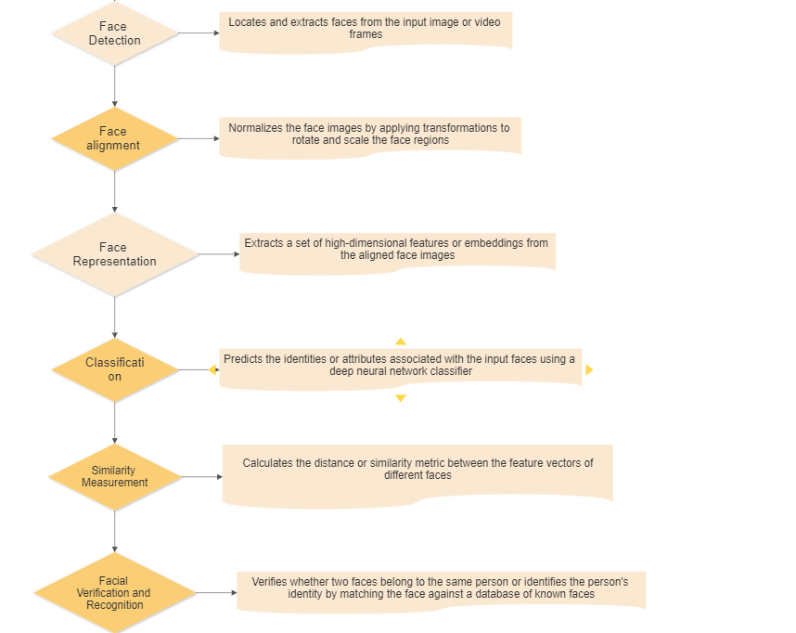
Algorithm (Flow Diagram)

Slide 8
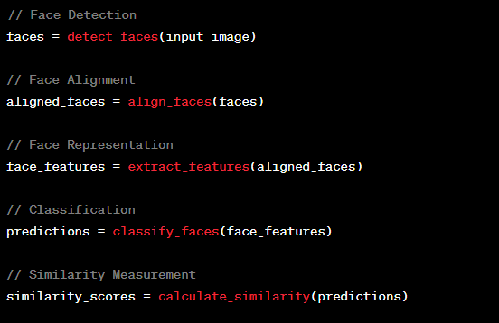
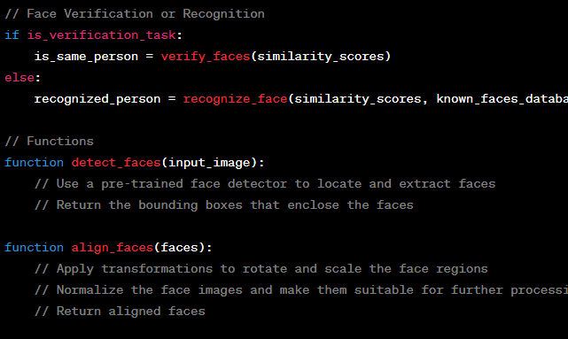

Slide 9
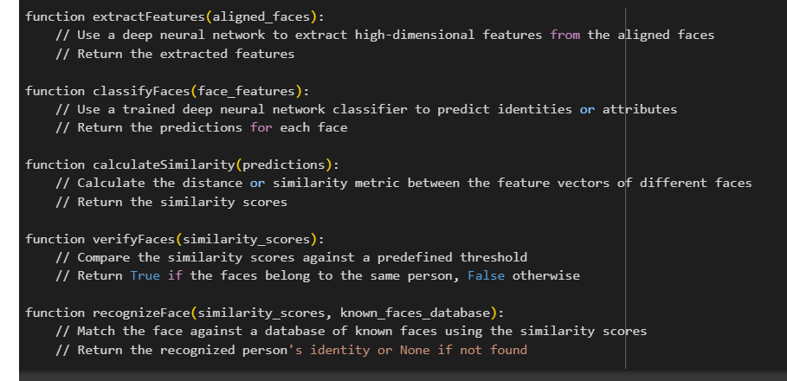

Slide 10


Applications
Facial Recognition
Emotion Analysis

Slide 11
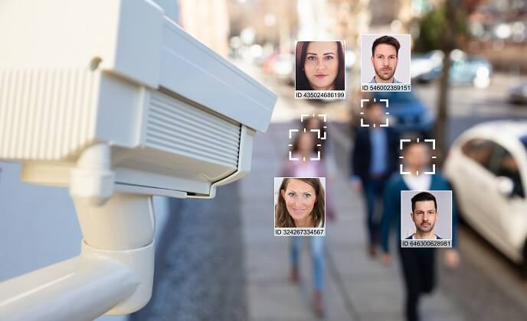
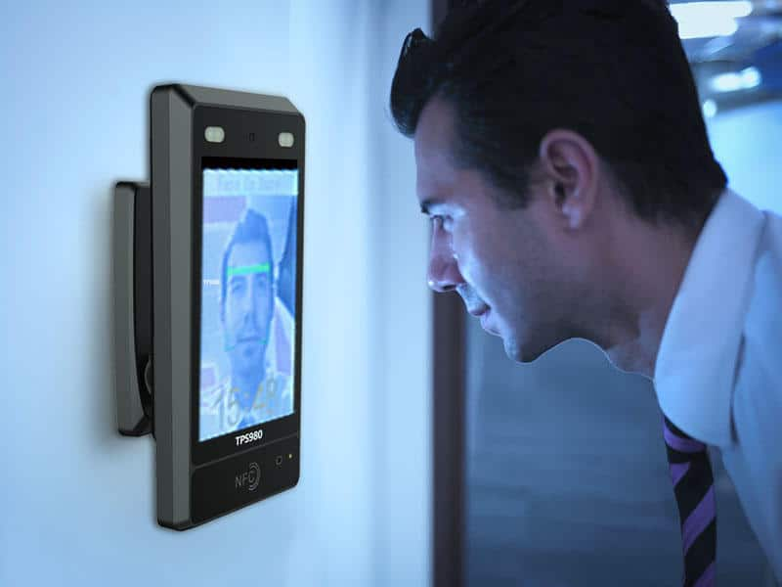
Video Surveillance
Biometric Authentication

Slide 12
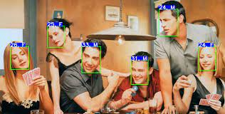
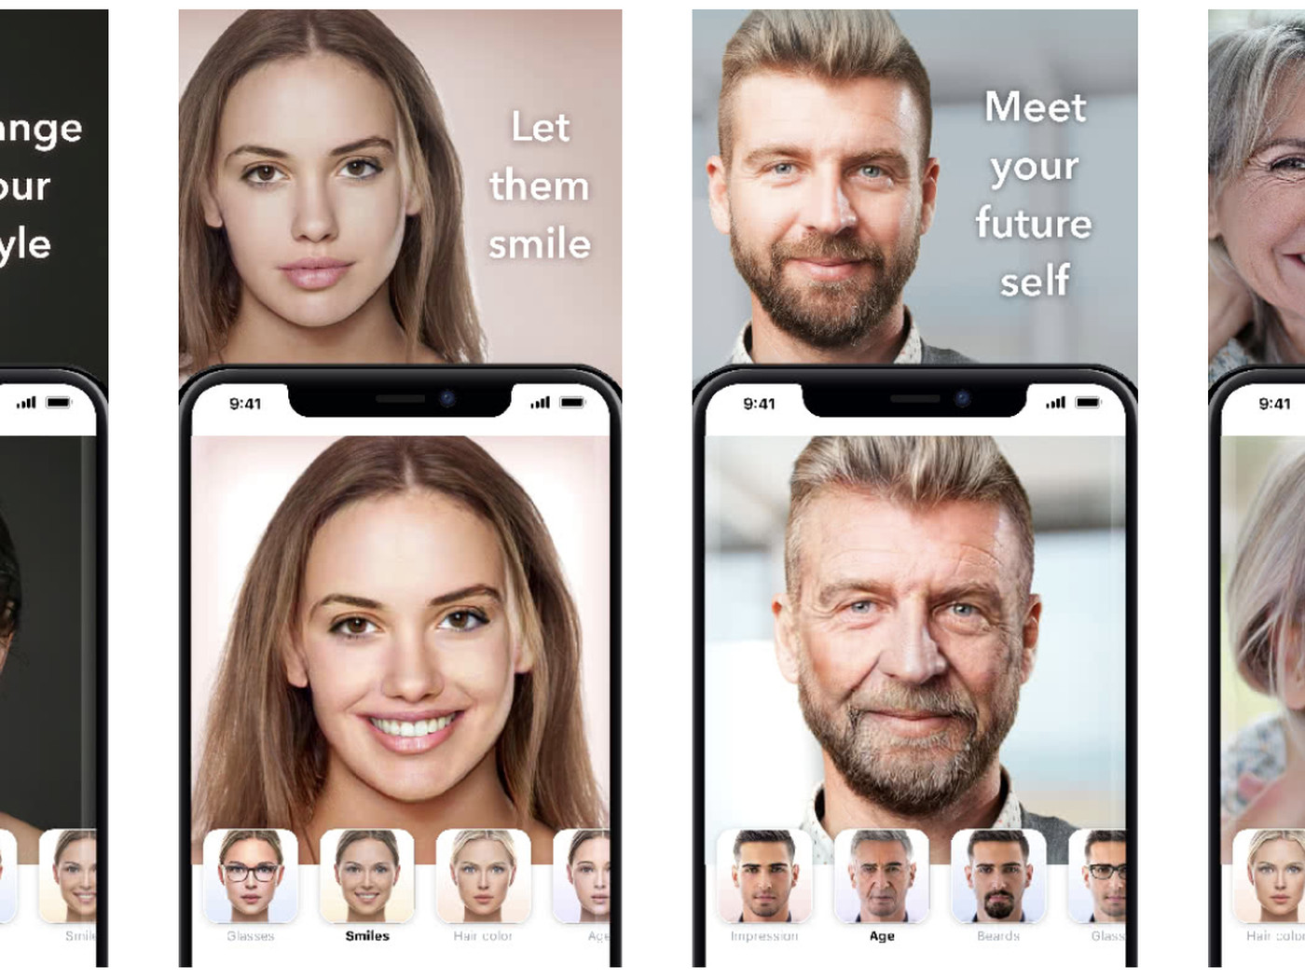
Age and gender Estimation
Social Media Filters and Effects

Slide 13

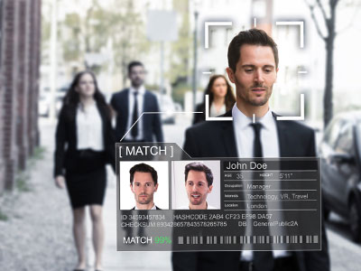
Entertainment and Gaming
Law Enforcement

Slide 14
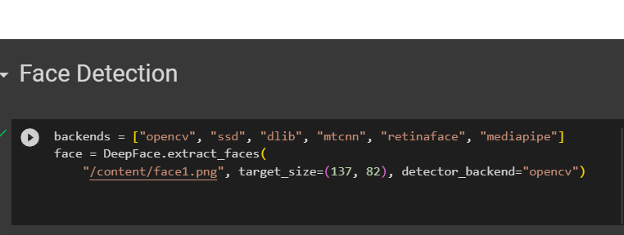
Code Snippets

Slide 15
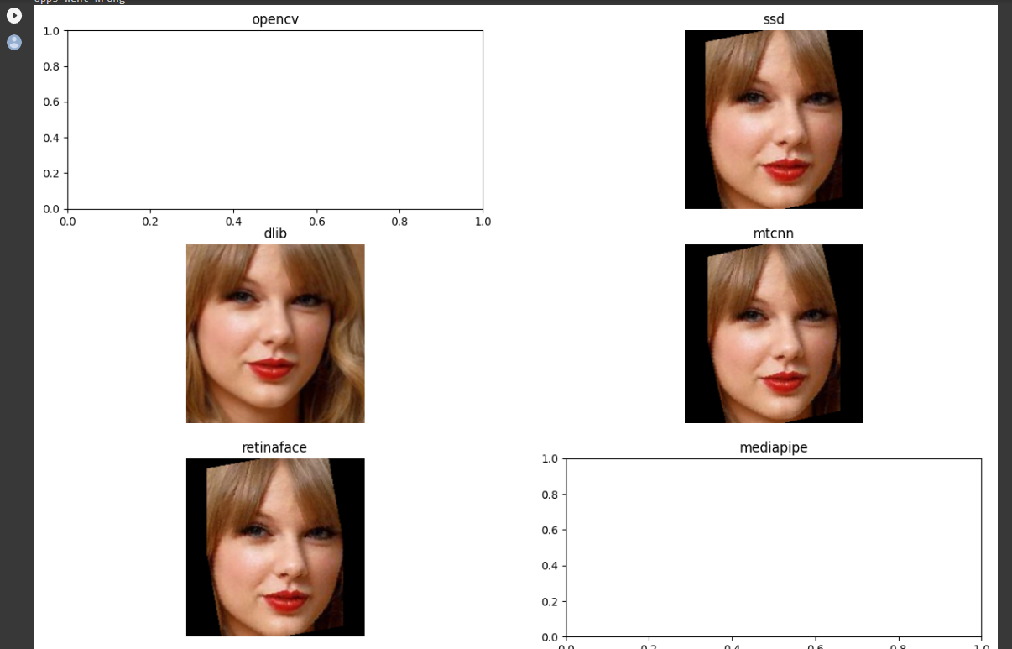

Slide 16
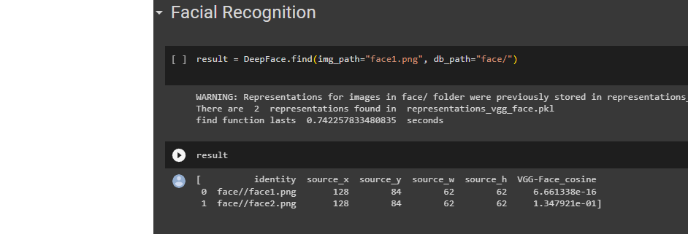

Slide 17
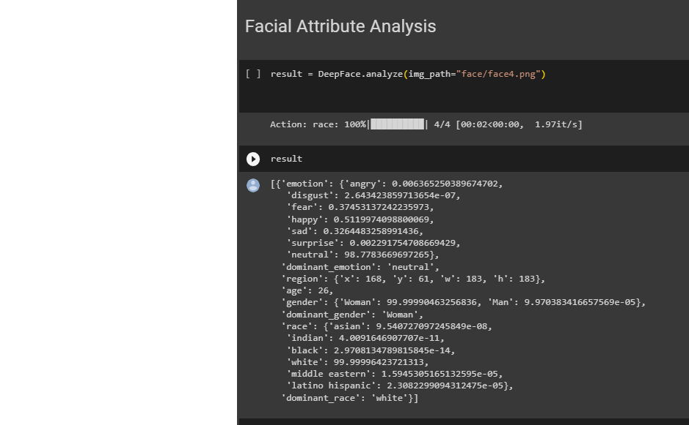

Slide 18
Conclusion
Facial recognition algorithms, such as the DeepFace approach developed by Facebook, utilize computer vision and deep learning to analyze and recognize human faces. They have applications in security, access control, social media, and entertainment. Face detection enhances security measures in law enforcement and access control systems, while also enabling real-time filters and effects on social media platforms. Additionally, it aids in entertainment and gaming applications, retail analytics, and personal safety.
However, there are limitations to consider. Dataset bias, variations in environmental factors, and privacy concerns pose challenges. Biased training datasets can lead to inaccurate results, environmental variations affect accuracy, and privacy concerns arise due to personal data collection. Future enhancements can include improving robustness, exploring advanced architectures, integrating privacy-preserving techniques, and leveraging multi-modal approaches. Continuously updating datasets and developing efficient implementations can further enhance performance and scalability.

Slide 19
REFERENCES
OpenCV: https://opencv.org/ - OpenCV is an open-source computer vision library that provides various tools and algorithms for face detection and recognition.
Dlib: http://dlib.net/ - Dlib is a modern C++ toolkit that includes facial detection and recognition algorithms, as well as other computer vision and machine learning tools.
PyImageSearch: https://www.pyimagesearch.com/ - PyImageSearch is a blog that provides tutorials and resources on various computer vision topics, including face detection using Python and OpenCV.
Face Detection Homepage: http://www.face-detection.org/ - This website serves as a comprehensive resource for face detection algorithms, datasets, benchmarks, and research papers.
FaceNet: A Unified Embedding for Face Recognition and Clustering: This research paper introduces the FaceNet model, which is closely related to DeepFace and focuses on face recognition and clustering using deep neural networks. Link: arxiv.org/abs/1503.03832

Slide 20
Thank You !

